Slide 1
Problems, Paradoxes and probability
Diomides Mavroyiannis

Slide 2
Teaching approach: Popperian
Start with a problem or paradox
Ask students why this might be an important problem.
Give standard answers why the problem is important
Explain that a solution is often not just a question of calculation but about using the appropriate categories.

Slide 3
How do resolve a paradox?
Normative: We realize the question is badly framed, we need additional information.
Descriptive: We change the information structure or the optimand

Slide 4
Example: Risk vs Uncertainty
Allais and Ellsberg
If we assume people are acting with a probability in mind we have an incoherence about how people assign value.
If the probability is incomplete, the paradox is resolved.

Slide 5
Function of decision theory: Two approaches
Normative: Are we trying to create tools that people can use to make decisions?
Descriptive: Are we trying to explain why people decide as they do?

Slide 6
Components of decision theory
Probability: The confidence in the connection between actions and outcomes.
Payoff: The outcomes that the decision maker knows can occur.
Knowledge high ➔ probability important
Knowledge low ➔ Payoff more important

Slide 7
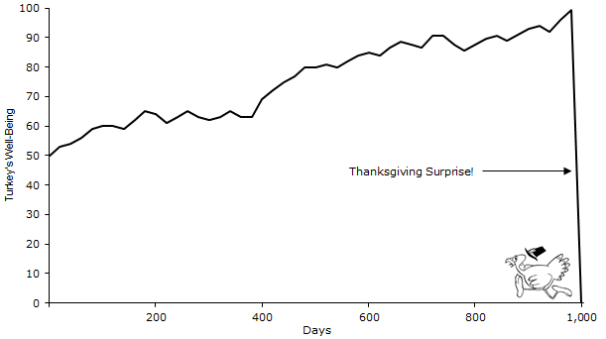
Example: The Turkey problem
Data is often insufficient
The question: is there convergence?

Slide 8
The causal ladder
The decision maker needs less information than the academic.
Counterfactual >Intervention >Association
You cannot talk about cause without a counterfactual. Strong implications for historical research.

Slide 9
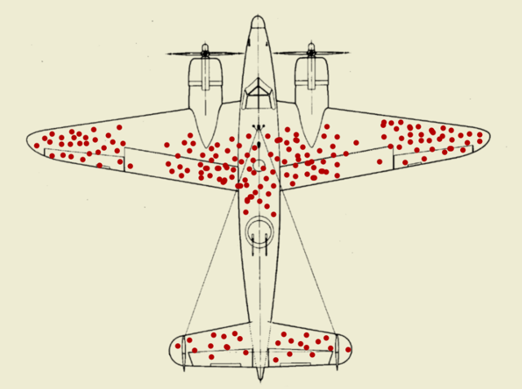
Causal: What can we infer from this picture?

Slide 10
Homework
The class content can easily be amenable to numerous methods of evaluation.
Problem questions in the form of pure mathematical problems
Essay questions on a specific paradox and its solution
Causal diagrams: What are the acceptable controls?

Slide 11
Example essay questions:
Counterfactual 1: « What if Hitler had tea instead of coffee on the day of his death? »,
Counterfactual 2: « what if Hitler did not die on April 30 1945 by suicide but instead through the assasination attempt on July 1944 ».
How does the causal ladder help indicate to us the relative importance of these counterfactuals?

Slide 12
Example:
Historians had a causal theory of rabbits foot bringing good luck, they would place much more attention to the forests and pets that were around the kings. If they failed to find rabbits in the viscinity they would then go on to see how rabbits foots could have arrived

